Slide 1
SST → Pyr connections
JUC and RAG
2016-7-30

Slide 2
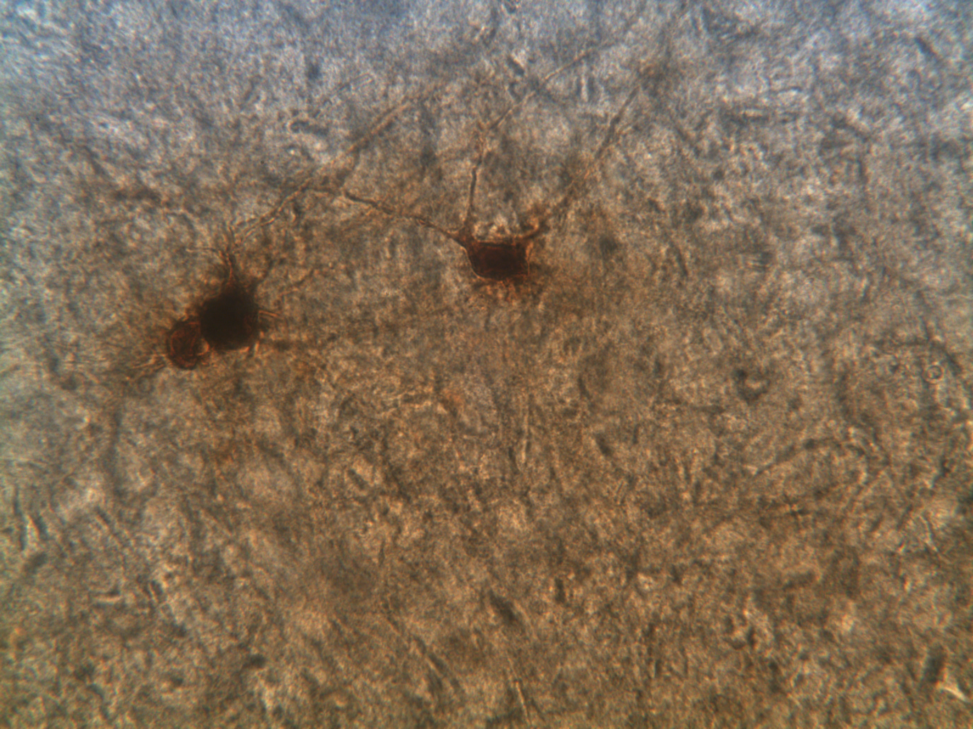
22Feb2016c: BF, 40X
RS
SST

Slide 3
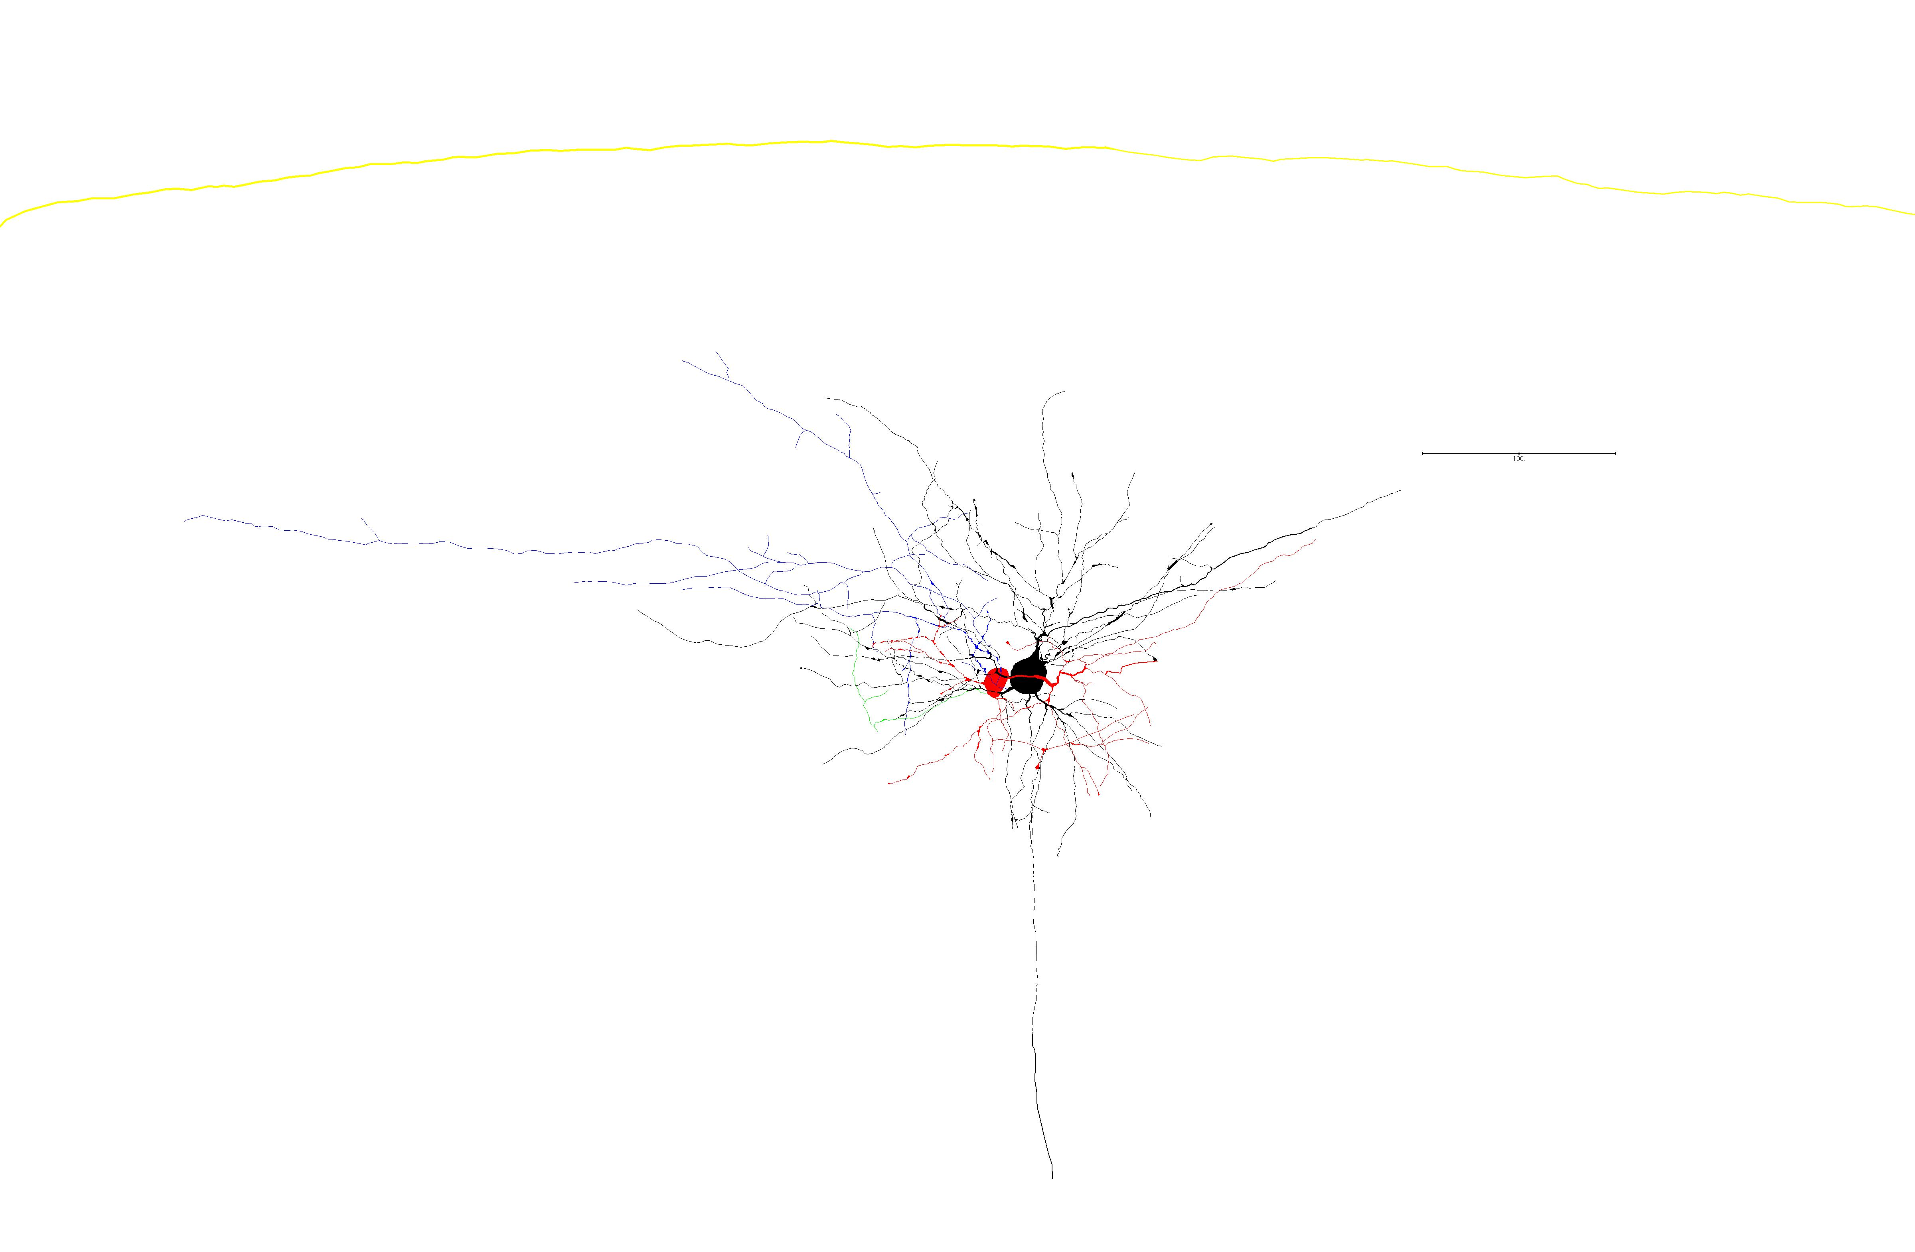
22Feb2016c: complete trace 4 synapses identified (30% confidence)

Slide 4
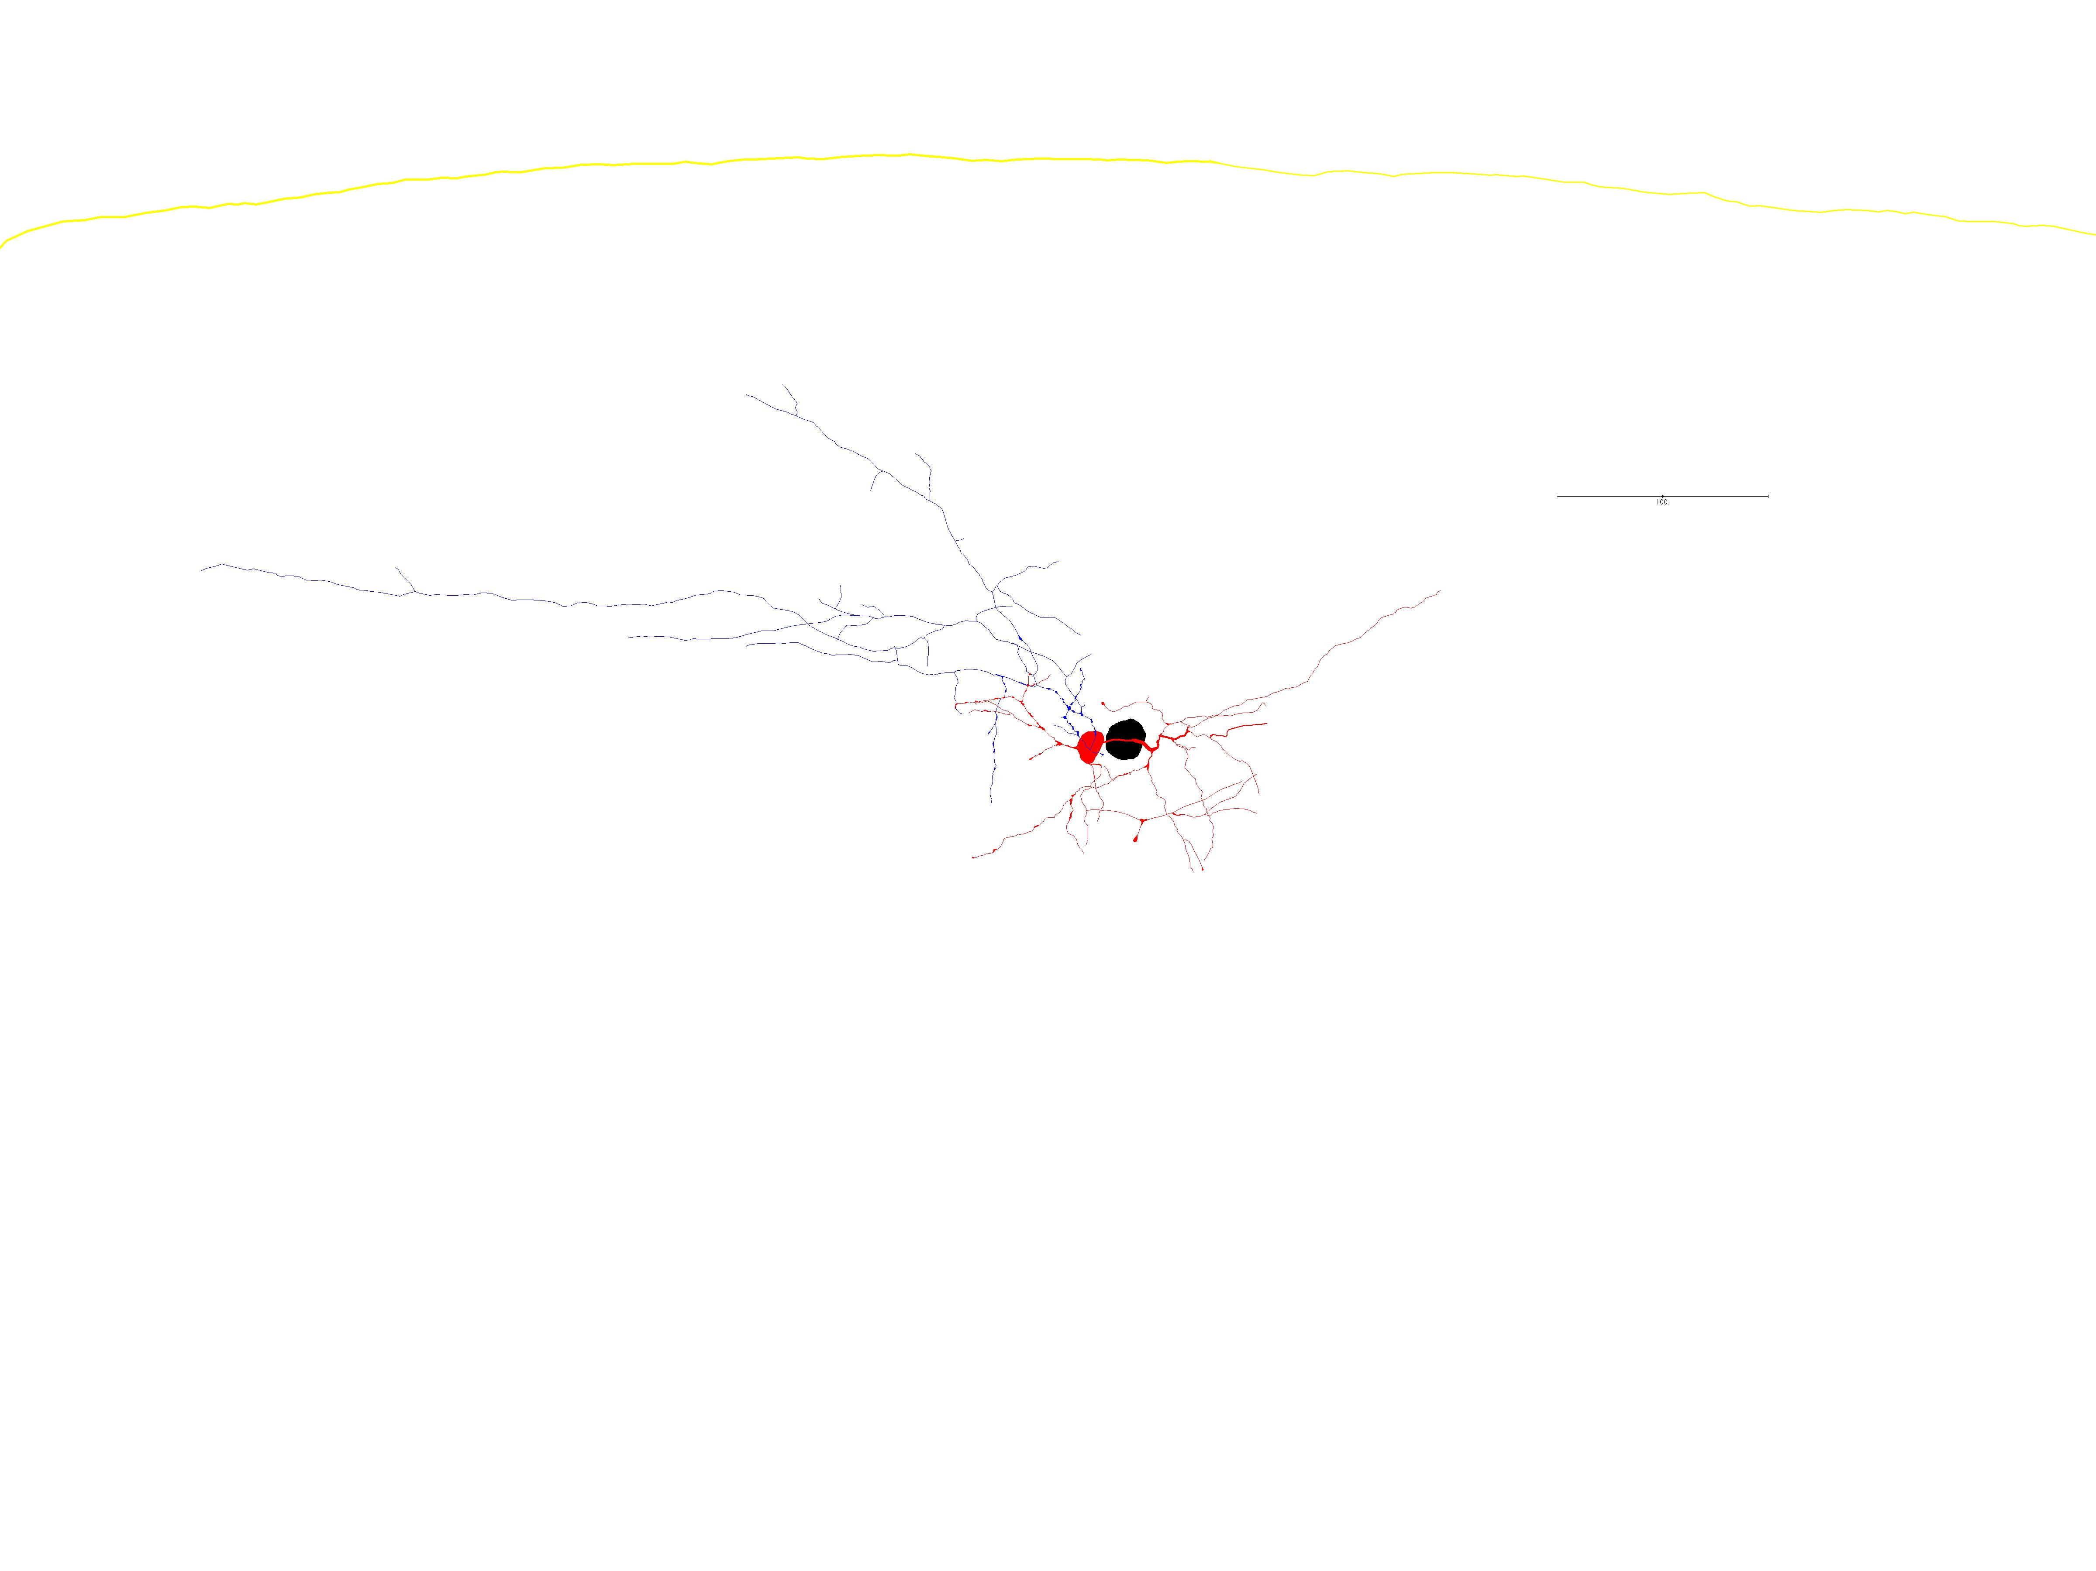
22Feb2016c: Pyr → SST

Slide 5
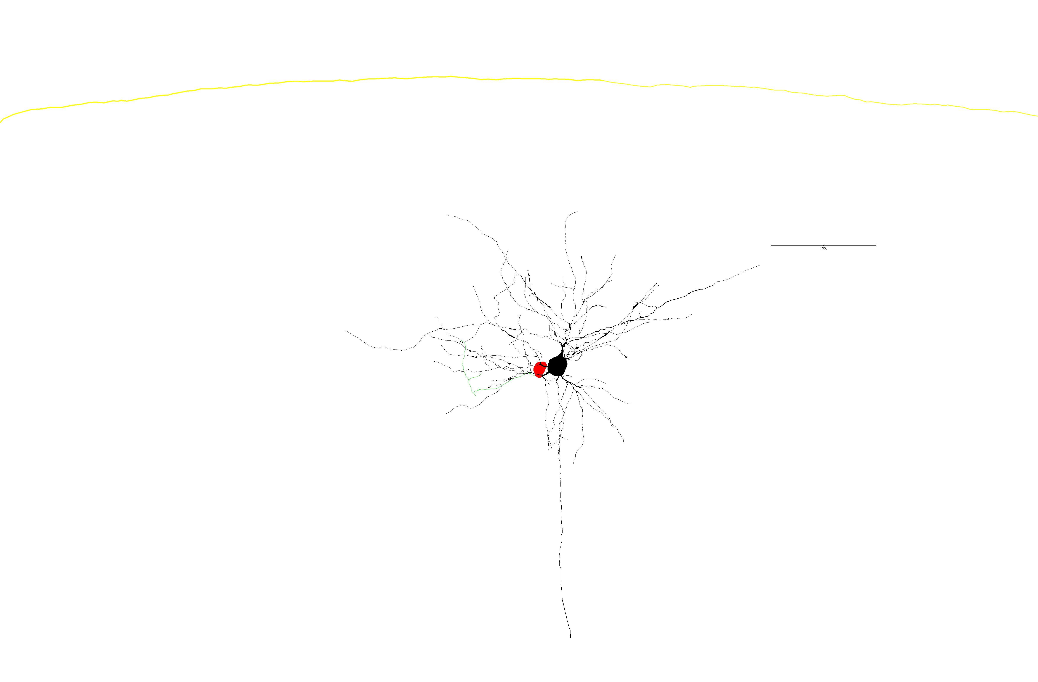
22Feb2016c: SST → Pyr

Slide 6
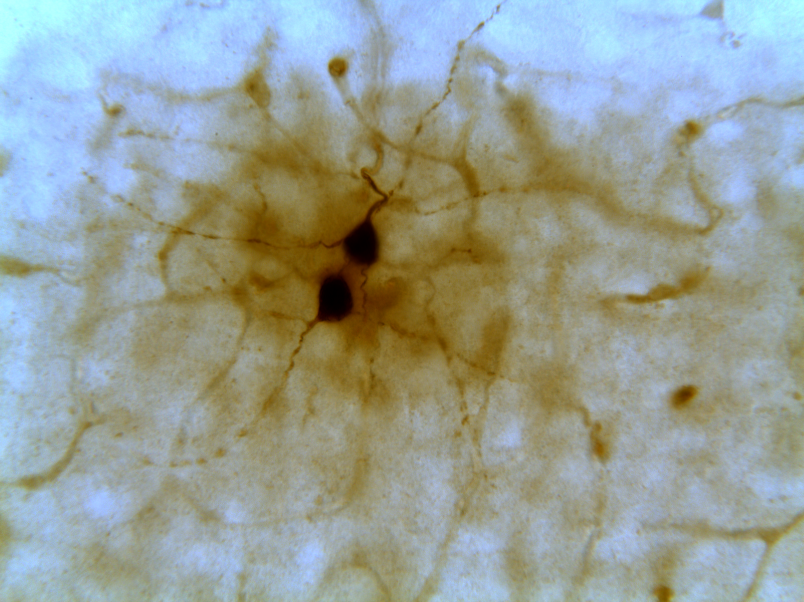
17Mar2016g: BF, 40X
RS
SST

Slide 7
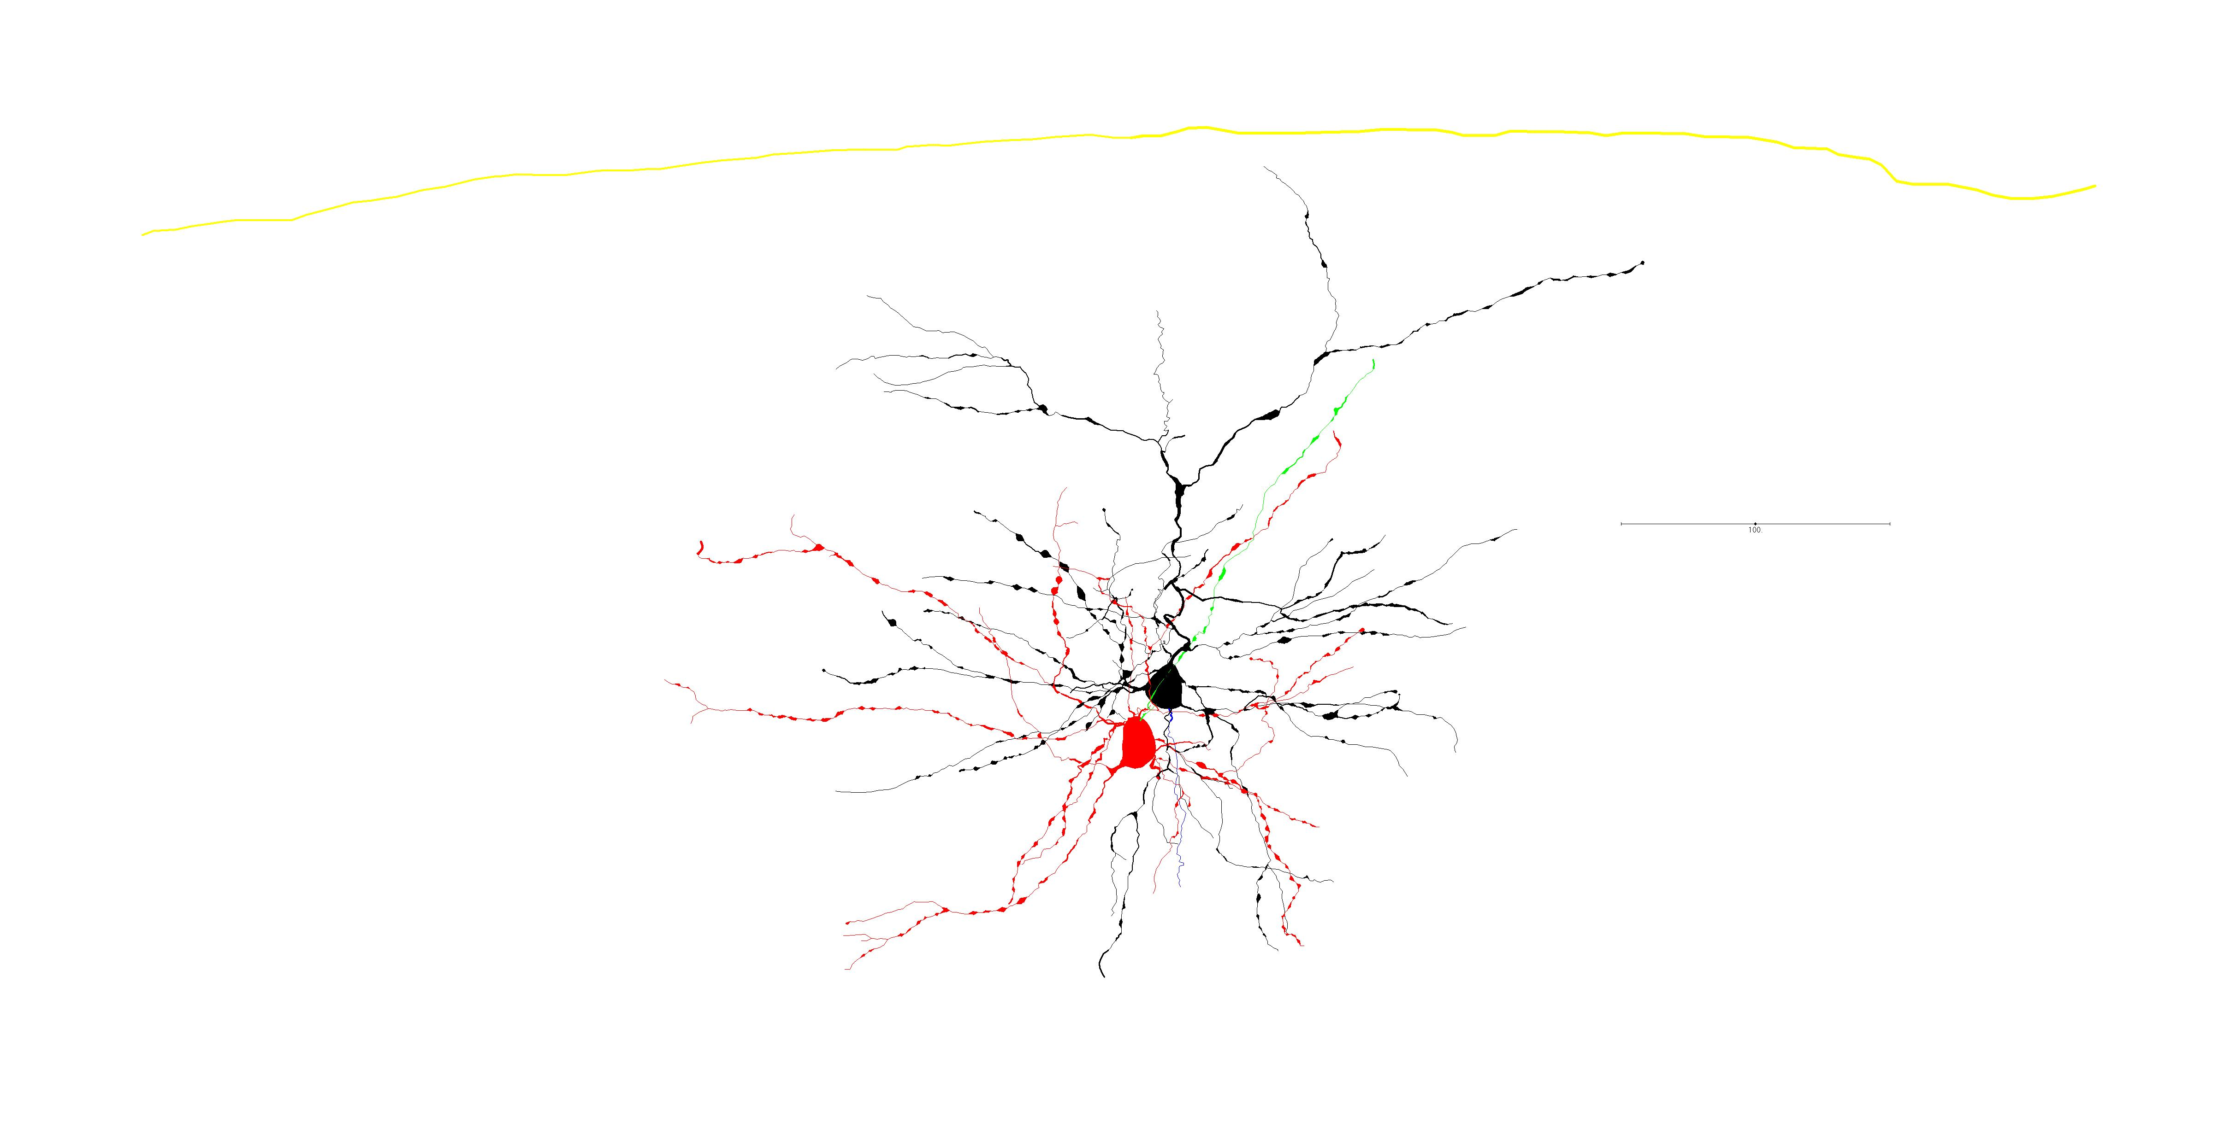
17Mar2016g: complete trace 5 synapses identified (85% confidence)

Slide 8
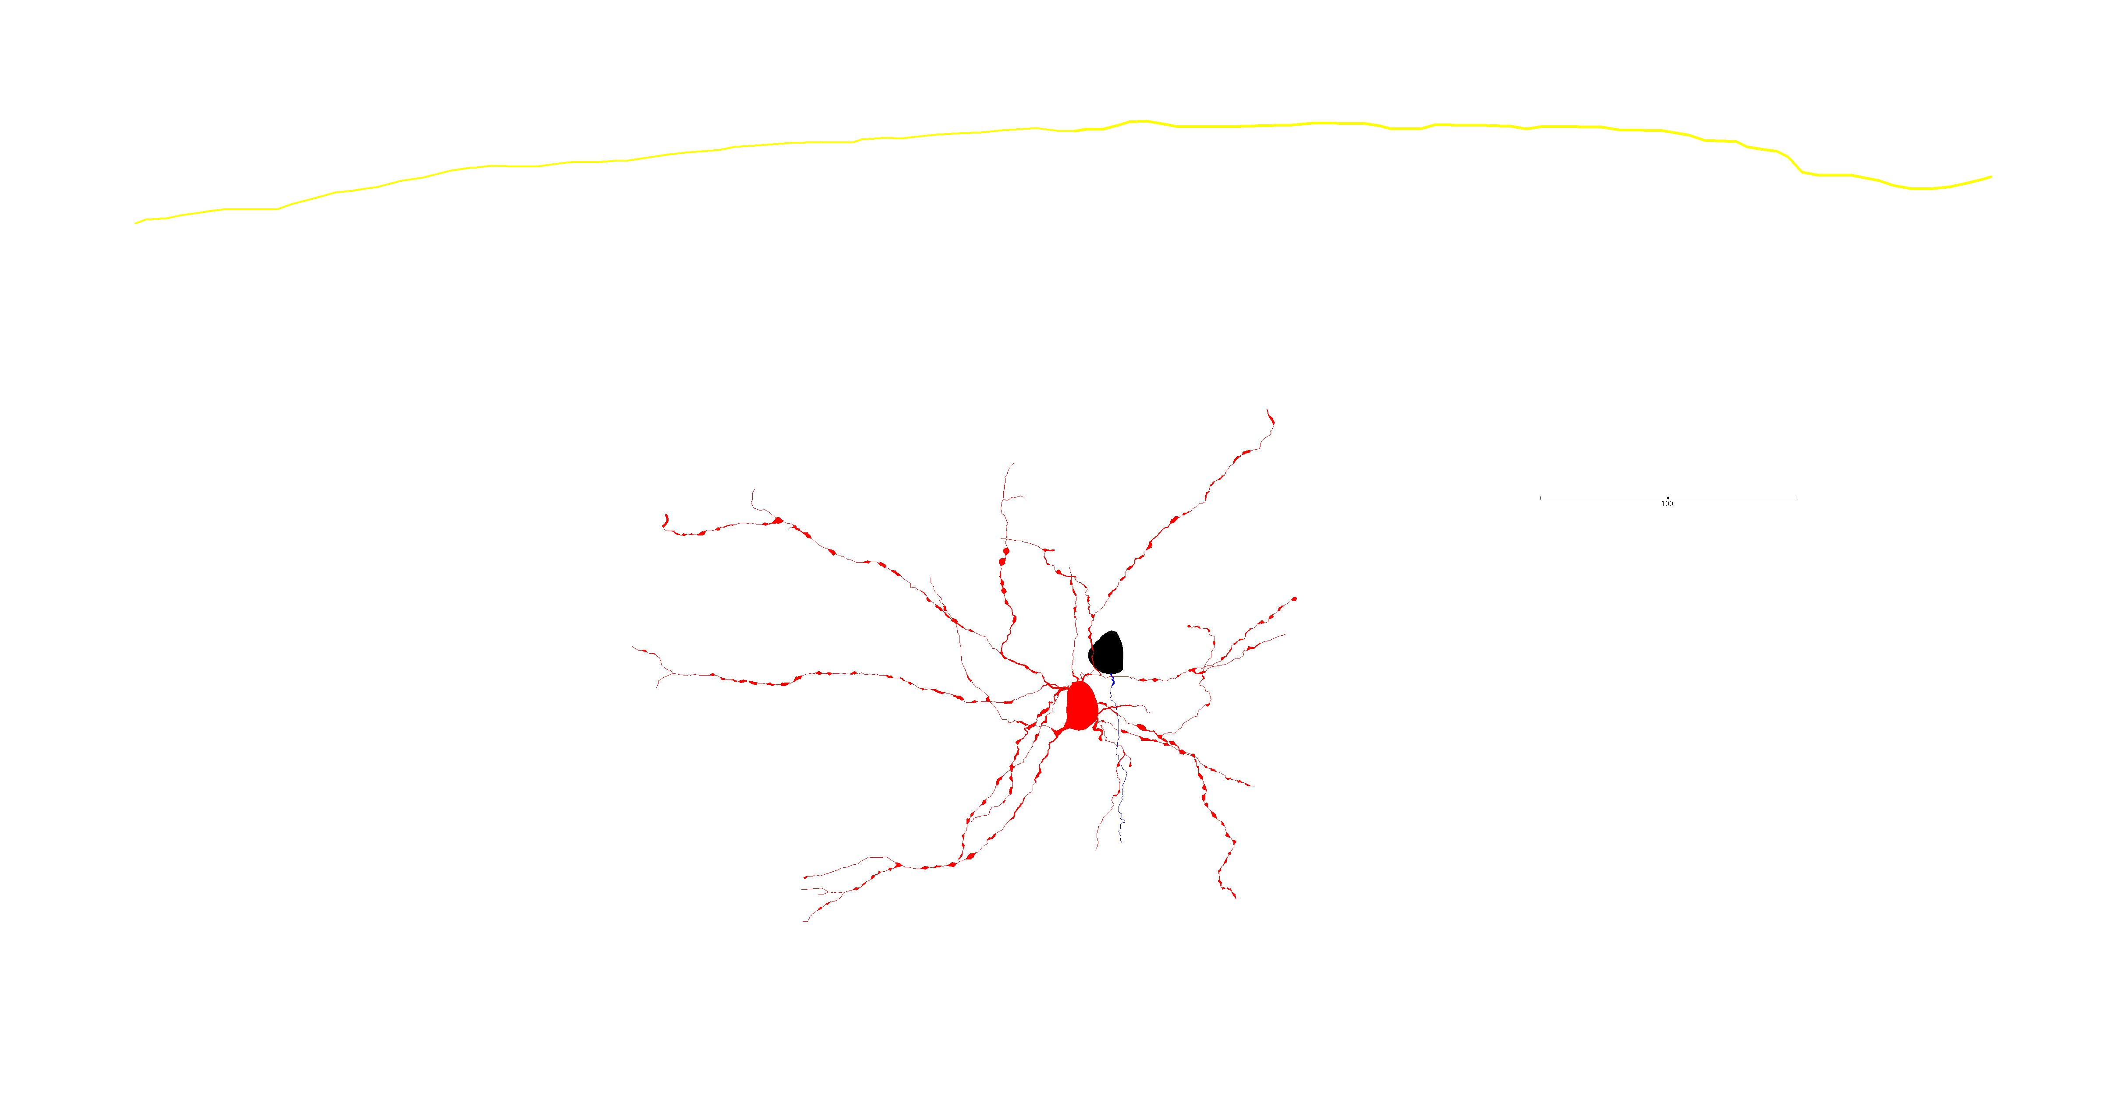
17Mar2016g: Pyr → SST

Slide 9
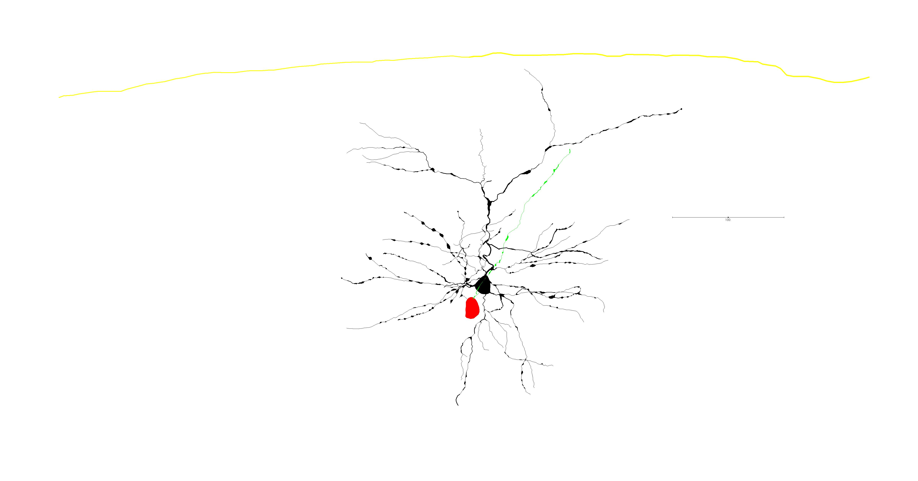
17Mar2016g: SST → Pyr

Slide 10
17Mar2016g: small EPSC
Pyramidal trace: blue
SST trace: red
Pyramidal trace offset -60mV
Ylims: -62 - -64 mV
Xlims: 2.395 – 2.515 s
Amplitude: 0.58594 mV
Sweep: 5
Spike: 9

Slide 11
17Mar2016g: medium EPSC
Pyramidal trace: blue
SST trace: red
Pyramidal trace offset -60mV
Ylims: -62 - -64 mV
Xlims: 2.35 – 2.47 s
Amplitude: 2.002 mV
Sweep: 6
Spike: 8

Slide 12
17Mar2016g: large EPSC
Pyramidal trace: blue
SST trace: red
Pyramidal trace offset -60mV
Ylims: -62 - -64 mV
Xlims: 2.43 – 2.55 s
Amplitude: 5.56640 mV
Sweep: 6
Spike: 10

Slide 13
17Mar2016g: ephys summary
Quality: Excellent
Mean EPSC amplitude: 2.25786 mV
SD: 1.64380 mV
Overall failure rate: 8.636%

Slide 14
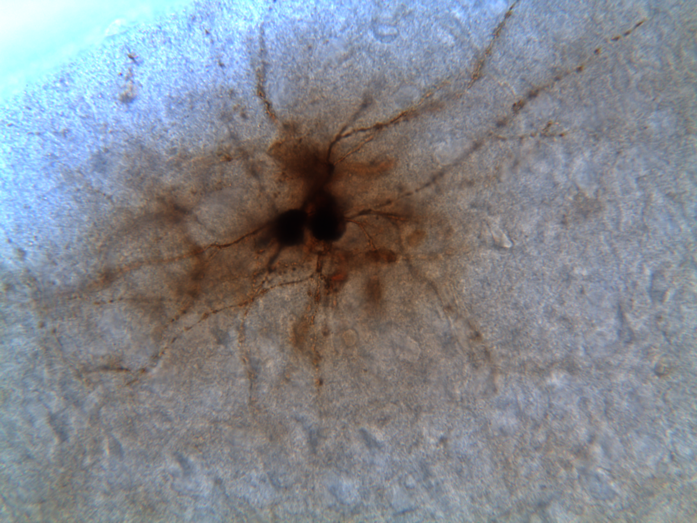
5May2016a: BF, 40X
RS
SST

Slide 15
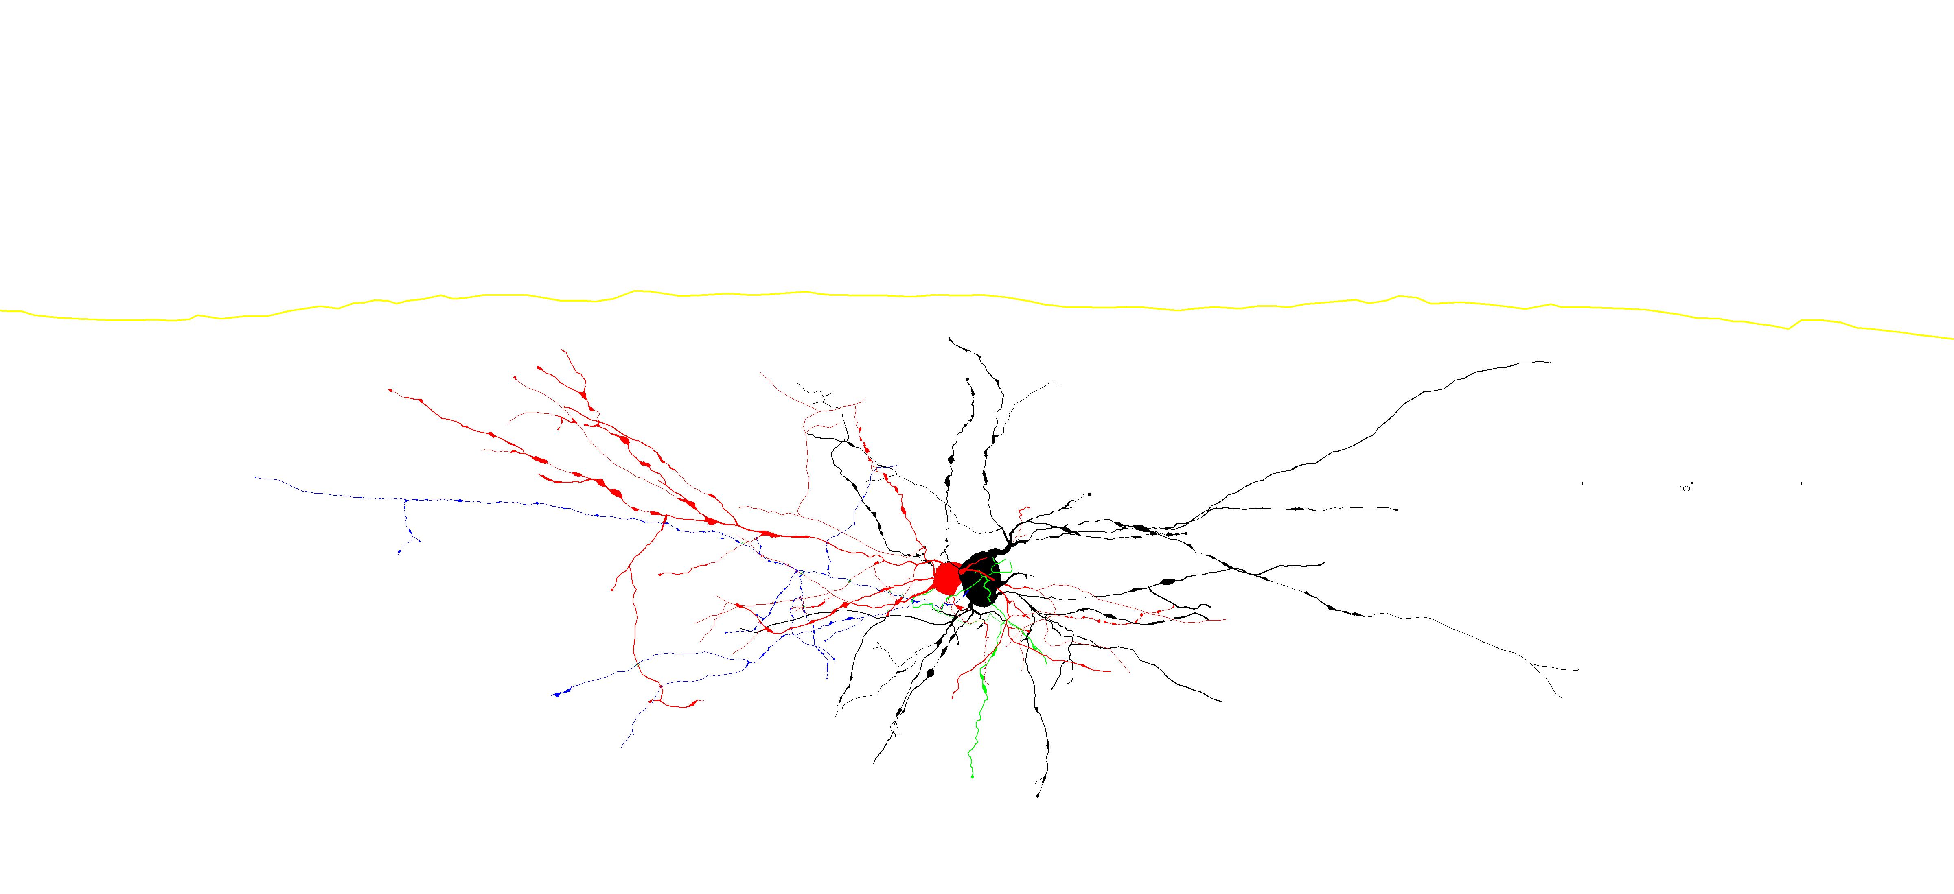
5May2016a: complete trace 10 synapses identified (80% confidence)

Slide 16
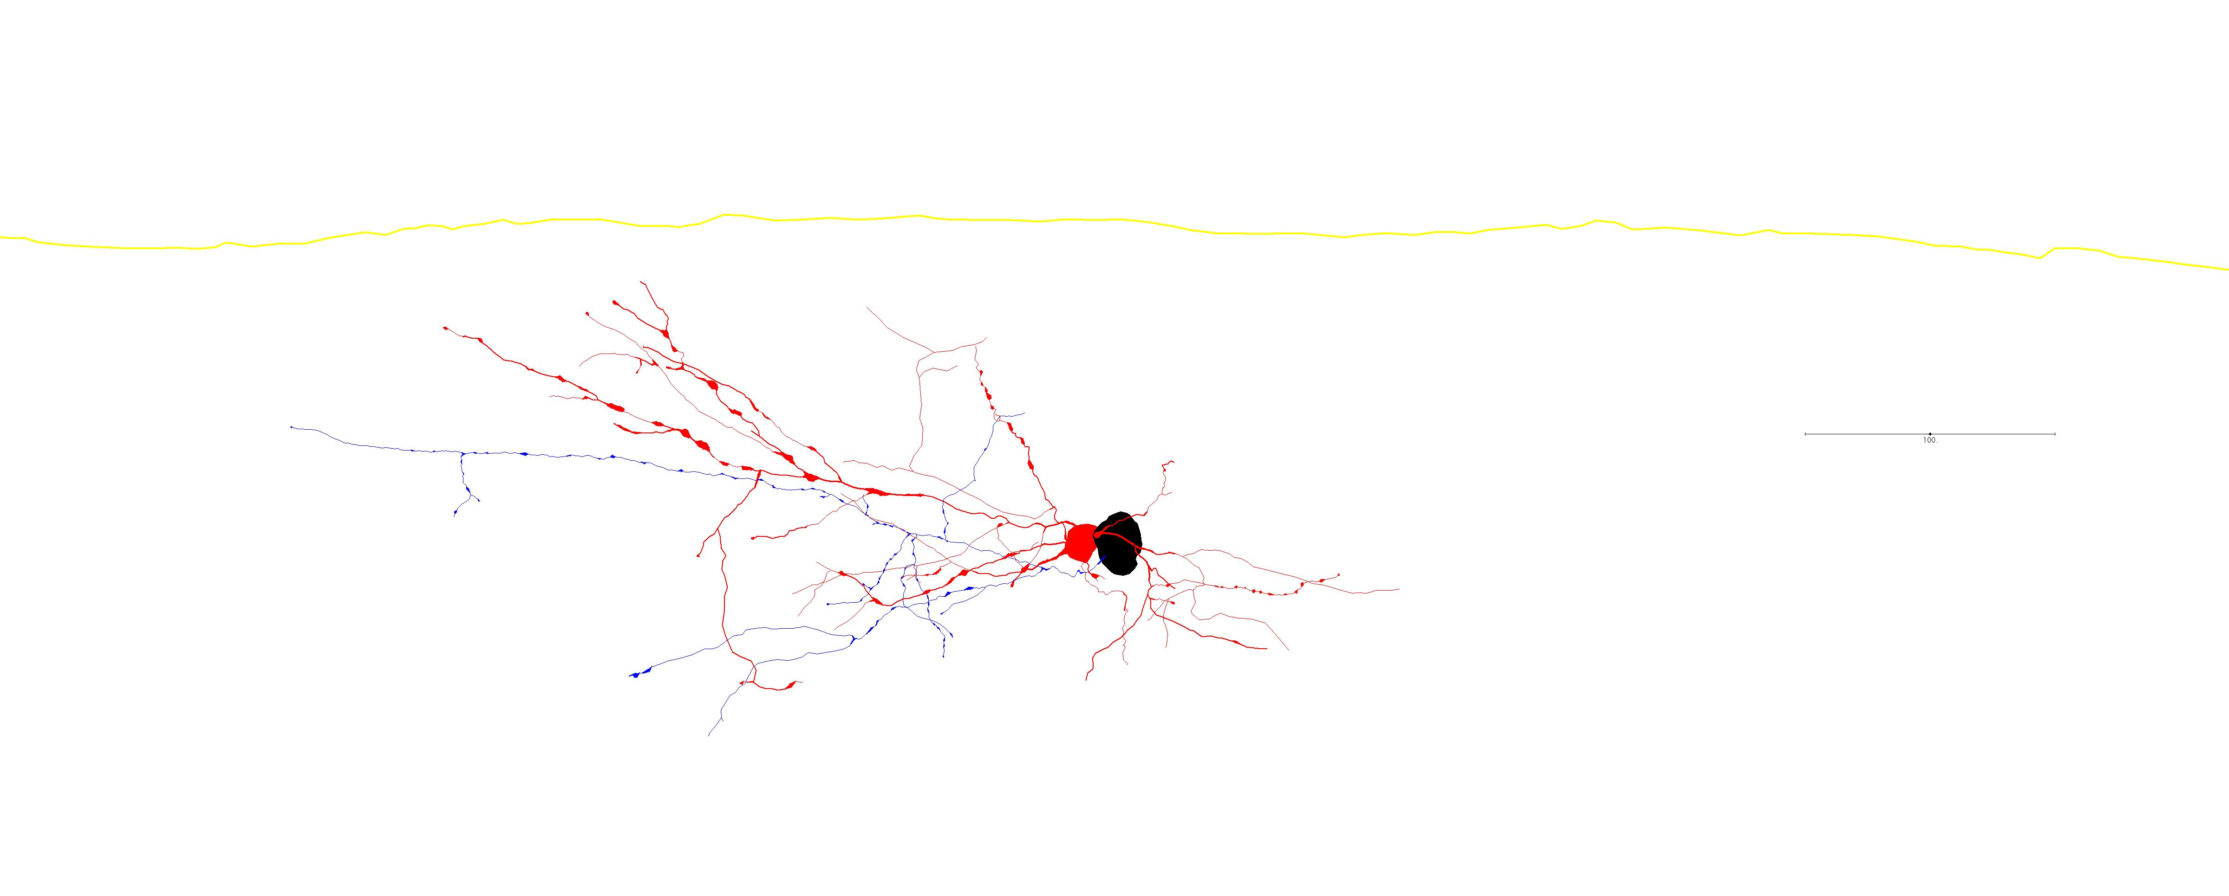
5May2016a: Pyr → SST

Slide 17
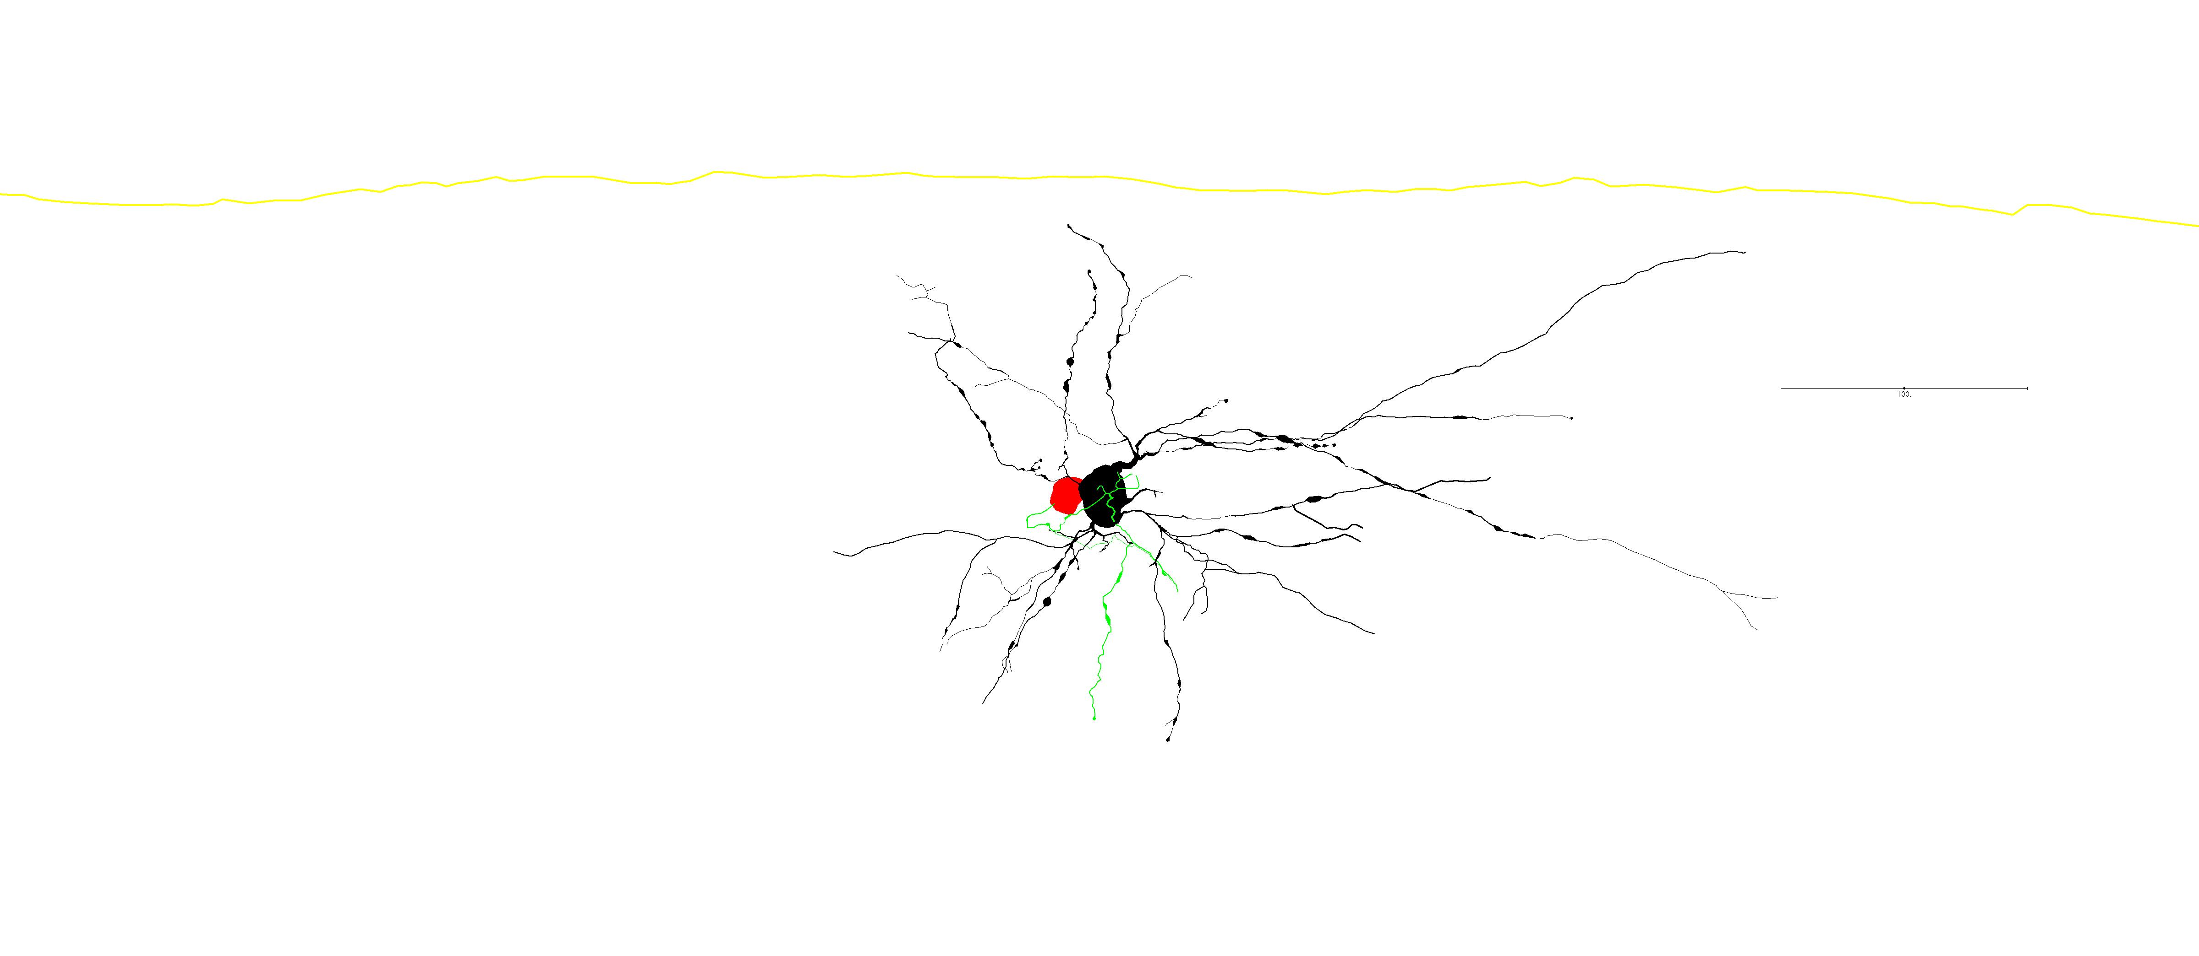
5May2016a: SST → Pyr

Slide 18
5May2016a: small EPSC
Pyramidal trace: red
SST trace: blue
Pyramidal trace offset -60mV
Ylims: -62 - -54 mV
Xlims: 2.35 – 2.47
Amplitude: 0.39062
Sweep: 10
Spike: 8

Slide 19
5May2016a: medium EPSC
Pyramidal trace: red
SST trace: blue
Pyramidal trace offset -60mV
Ylims: -62 - -54 mV
Xlims: 2.40 – 2.52 s
Amplitude: 1.51370
Sweep: 10
Spike: 9

Slide 20
5May2016a: ephys summary
Quality: moderate
Mean amplitude: 0.40500 mV
SD: 0.83199 mV
Overall failure rate: 49.852%

Slide 21
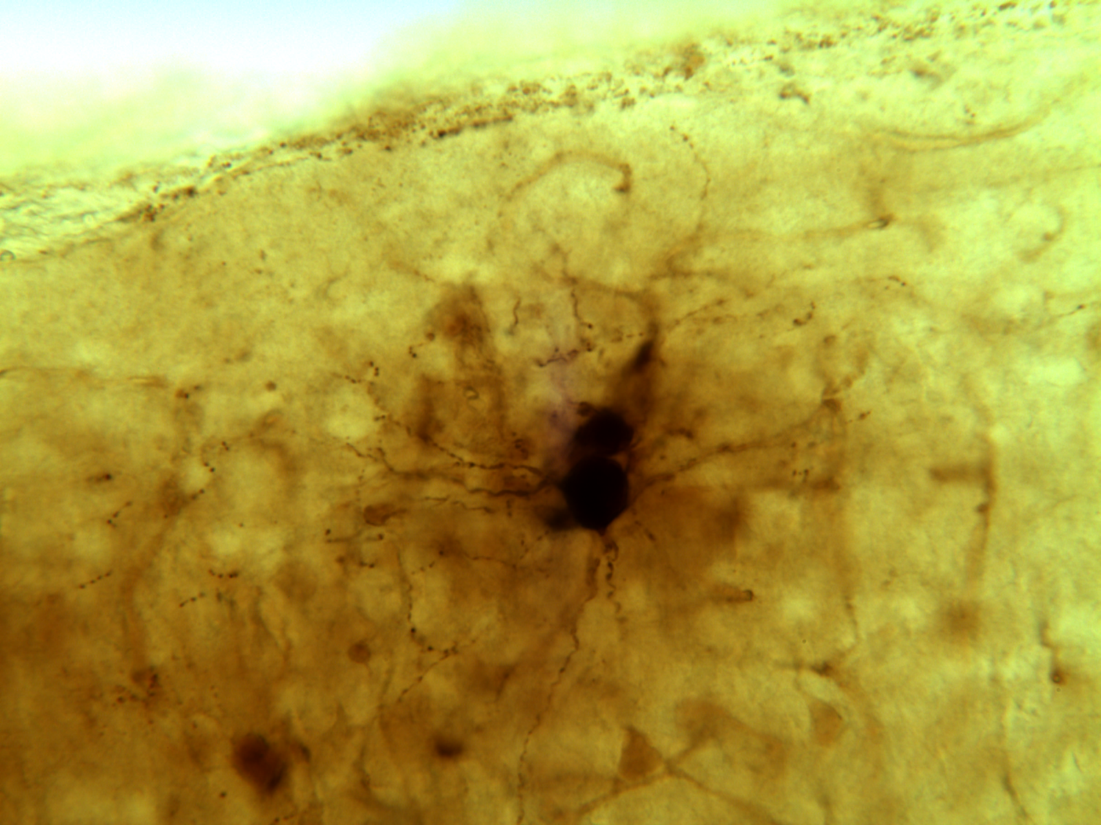
18Feb2016a: BF, 40X
SST
RS

Slide 22
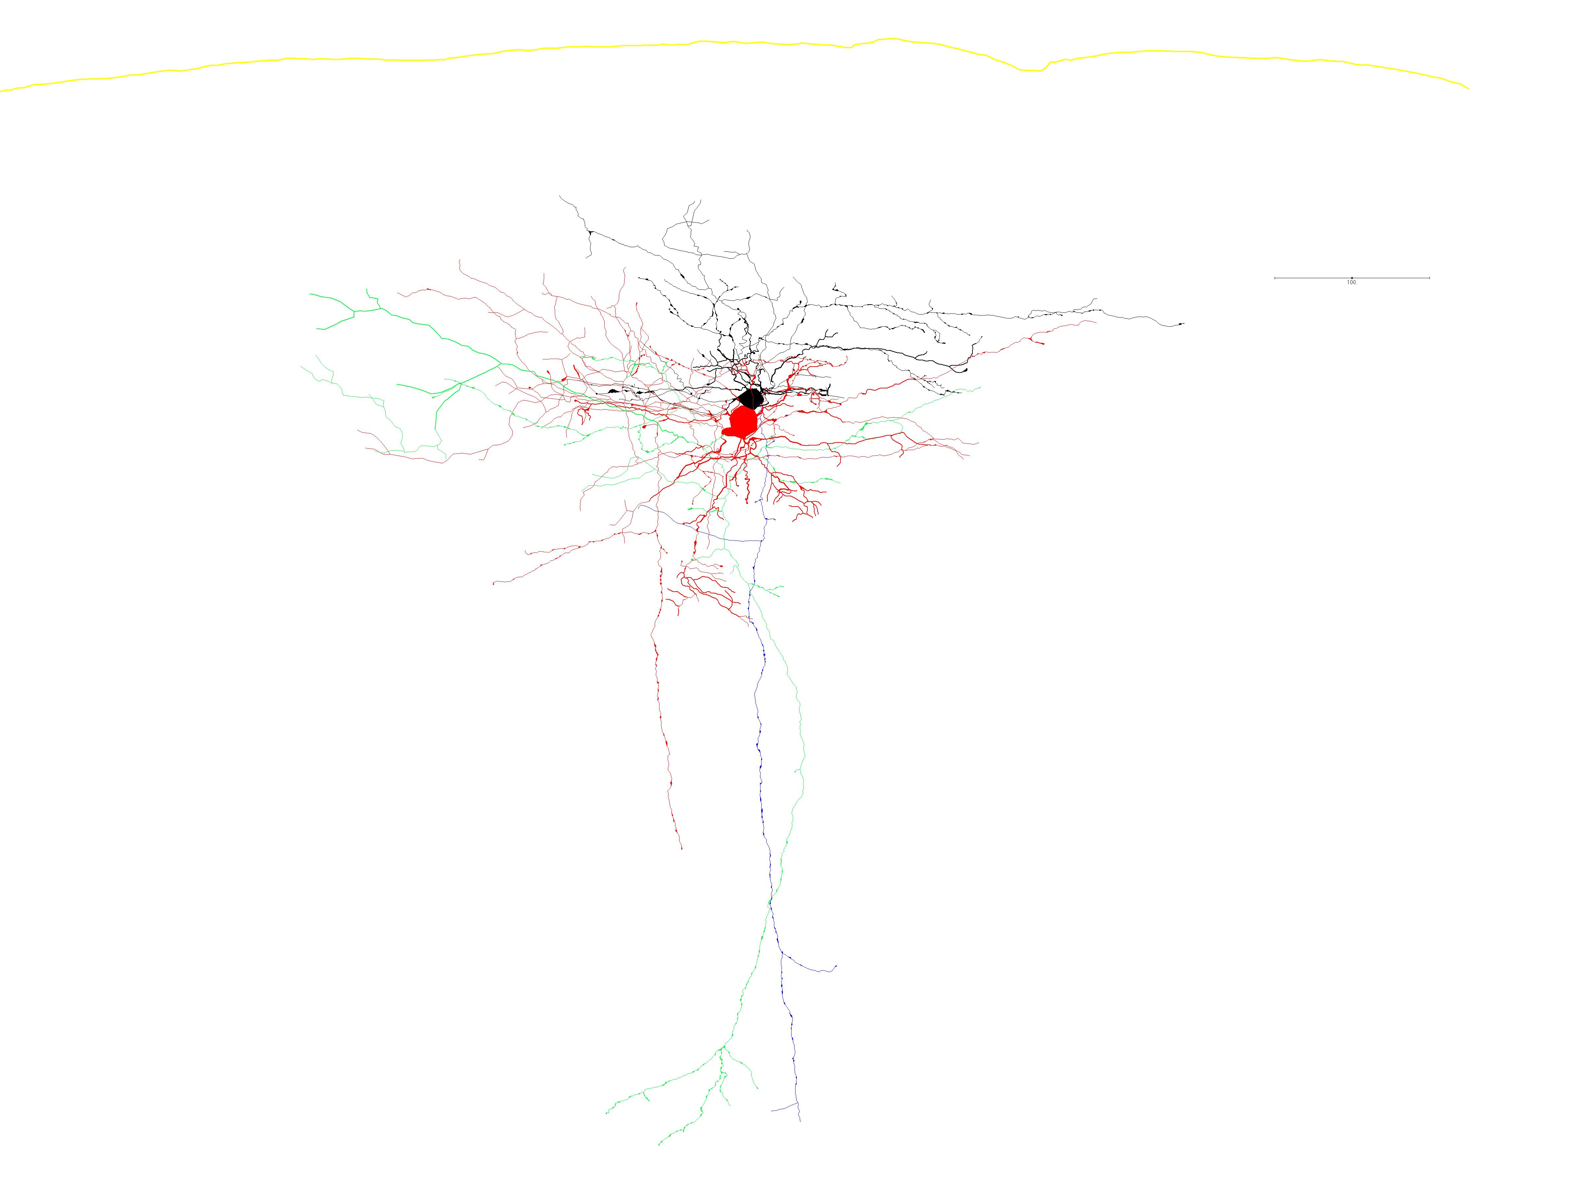
18Feb2016a: complete trace 3 synapses identified (55% confidence)

Slide 23
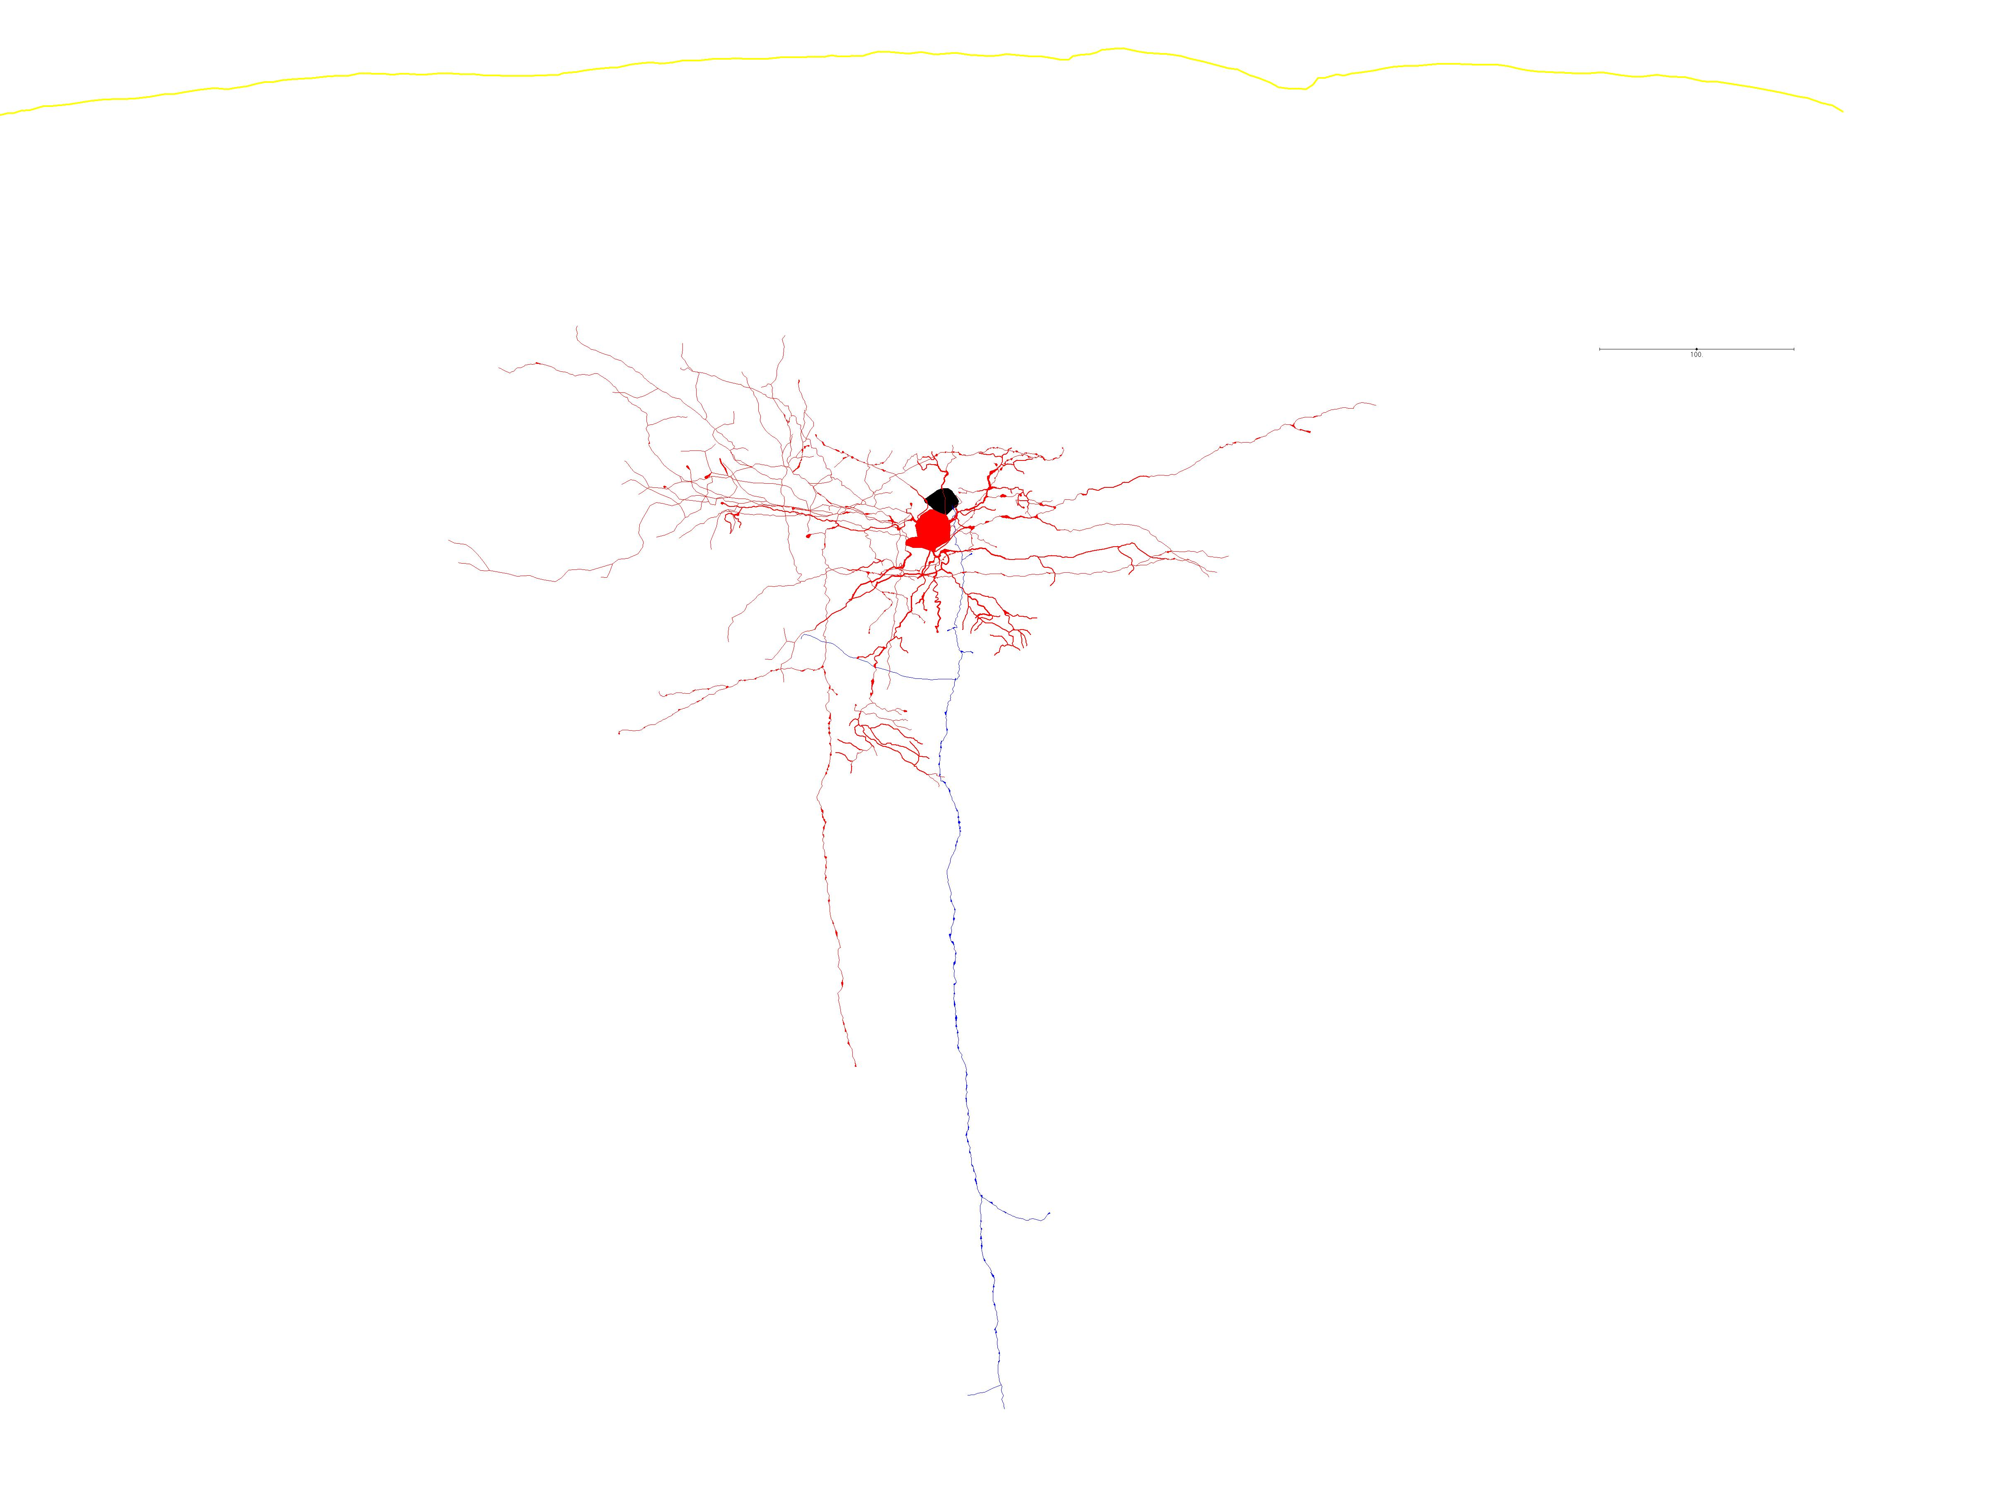
18Feb2016a: Pyr → SST

Slide 24
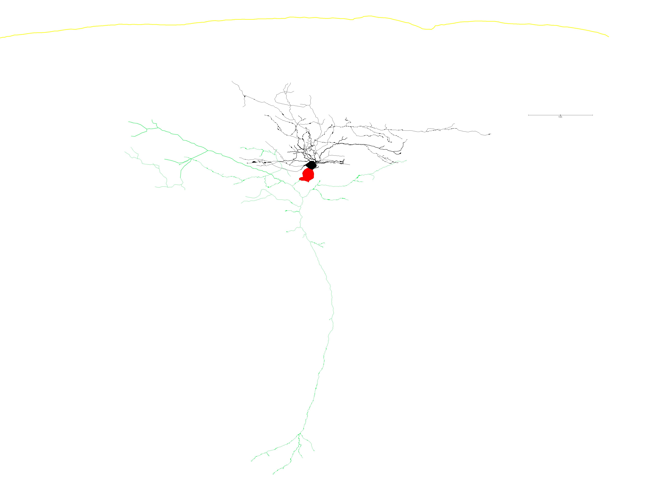
18Feb2016a: SST → Pyr

Slide 25
18Feb2016a: small EPSC
Pyramidal trace: blue
SST trace: red
Pyramidal trace offset -60mV
Ylims: -65 - -57 mV
Xlims: 2.20 – 2.32 s
Amplitude: 0.29297 mV
Sweep: 16
Spike: 5

Slide 26
18Feb2016a: medium EPSC
Pyramidal trace: blue
SST trace: red
Pyramidal trace offset -60mV
Ylims: -65 - -57 mV
Xlims: 2.35 – 2.47 s
Amplitude: 1.46480 mV
Sweep: 16
Spike: 8

Slide 27
18Feb2016a: large EPSC
Pyramidal trace: blue
SST trace: red
Pyramidal trace offset -60mV
Ylims: -66 - -58 mV
Xlims: 2.0 – 2.12 s
Amplitude: 3.75980 mV
Sweep: 26
Spike: 1

Slide 28
18Feb2016a: ephys summary
Quality: very good
Mean amplitude:
SD:
Overall failure rate:

Slide 29
18Feb2016c: ephys summary
Quality: Very good
Mean EPSC amplitude: 0.95119 mV
SD: 0.79018 mV
Overall failure rate: 9.524%

Slide 30
Jyotsna Pilli analysis, spring 2015
Where are Som-Pyr synapses onto L2 neurons?
26 Mar 2015 c
7/11 SOM-Pyr cnx are on apical dendrite 63.7%
13 Apr 2015 a
1/3 SOM-Pyr cnx are on apical dendrite 33%
Mean for n=2 is 48% of pyr-SOM connections are on apical dendrite

Slide 31
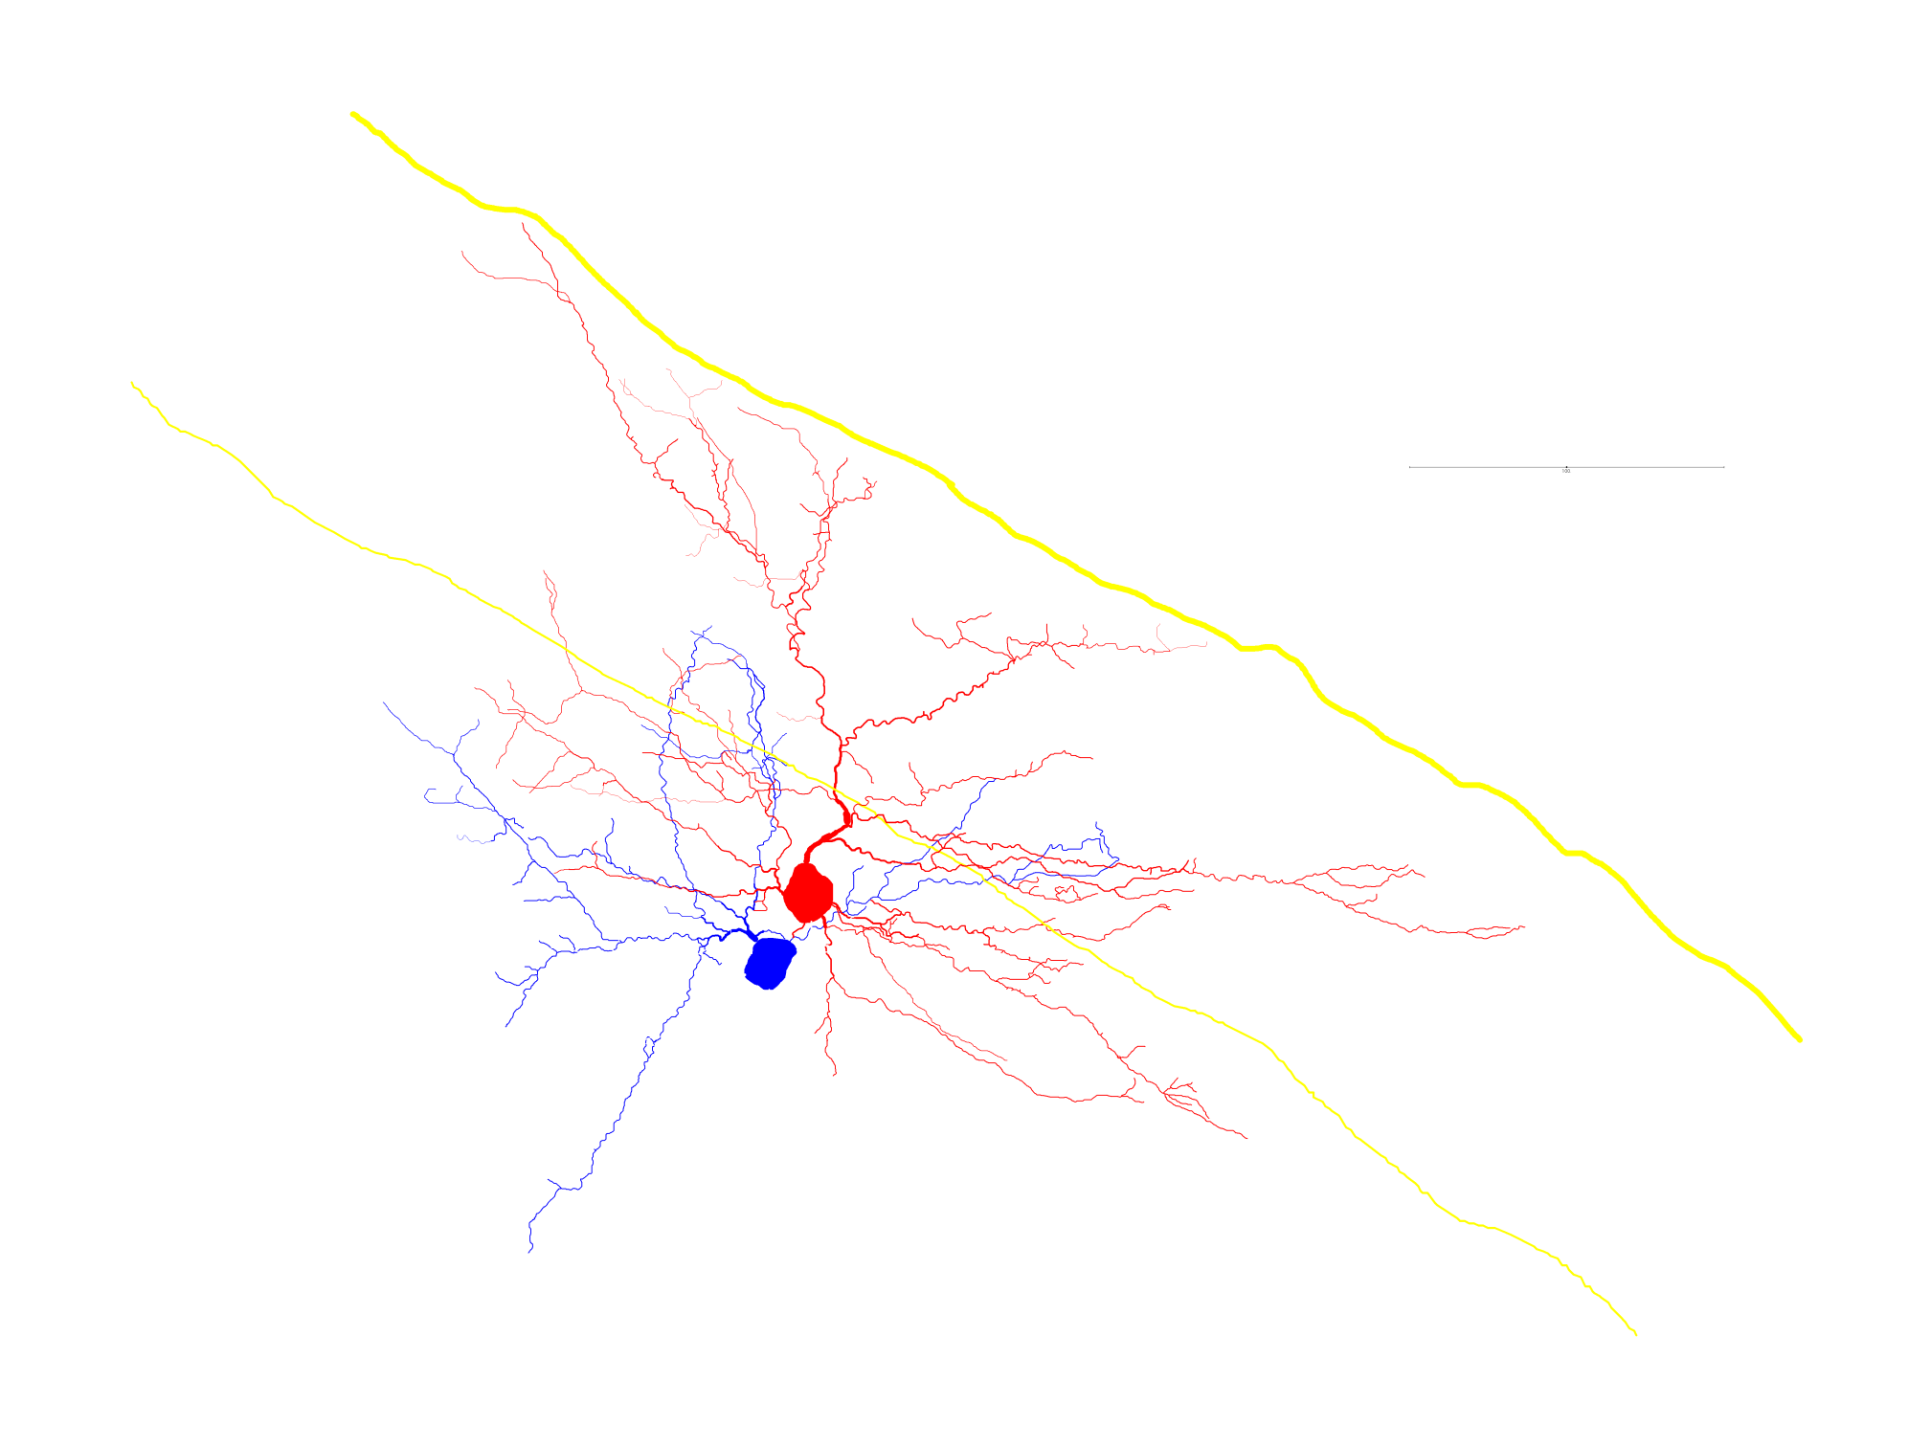
7/11 SOM-Pyr cnx are on apical dendrite
SOM-RS
SOM-RS
RS is red soma and dendrites
SOM is blue soma and axon
All connections verified by 3d imaging in neuroexplorer

Slide 32
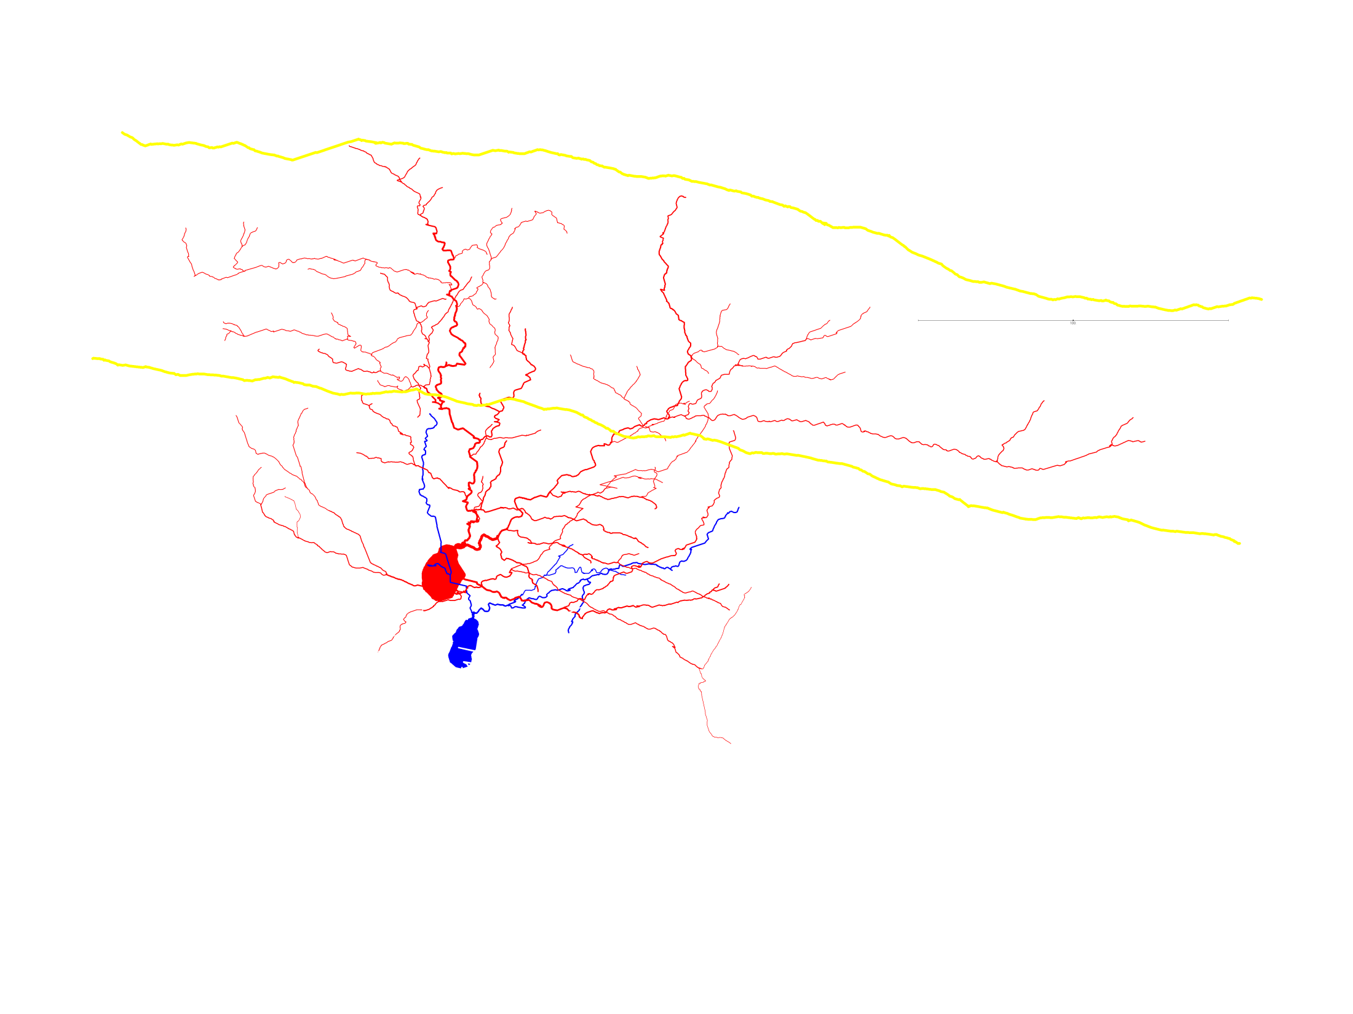
1/3 SOM-Pyr cnx are on apical dendrite
13 Apr 2015 a
SOM-RS conenctions displayed
RS red soma and dendrites
SOM blue soma and axon
All connections verified by 3d imaging in neuroexplorer

